Slide 1
AVL Tree
Parinya Sanguansat

Slide 2



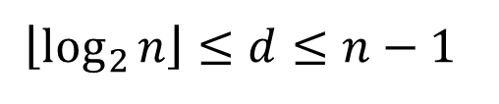



Why we need AVL Tree?
Binary Search Tree
The complexity depends on the depth of tree
BSTree for a set of data can represent in many ways
There is a way to get the best result
$$\left\lfloor \log_{2}{n}\right\rfloor ≤d≤n−1$$
best
average
worst
add remove contains
$$O(logn)$$
$$O(logn)$$
$$O(n)$$
treeSort
$$O(nlogn)$$
$$O(nlogn)$$
$$O(n^{2})$$

Slide 3
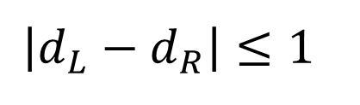
What is AVL Tree?
AVL = Self-balancing BSTree
AV+L = Adelson-Velskii and Landis
Binary Tree
Binary Tree
left
$$\left|d_{L}−d_{R}\right|≤1$$
right

Slide 4

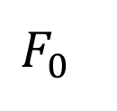
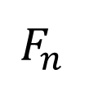

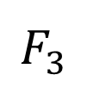
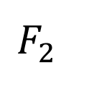
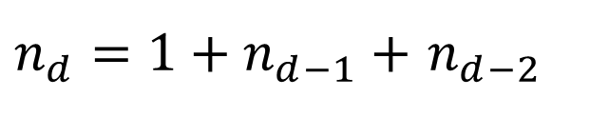
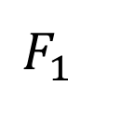

Depth of AVL Tree
$F_{d}$ = AVL Tree with minimal nodes, depth = d
$n_{d}$ = The number of nodes of $F_{d}$
$$F_{0}$$
$$F_{1}$$
$$F_{2}$$
$$F_{3}$$
$$F_{n}$$
$$F_{n−2}$$
$$F_{n−1}$$
$n_{d}=$ ${1+n}_{d−1}+$ $n_{d−2}$

Slide 5
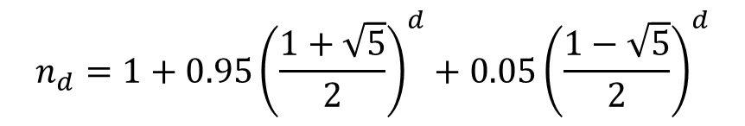
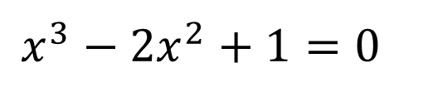
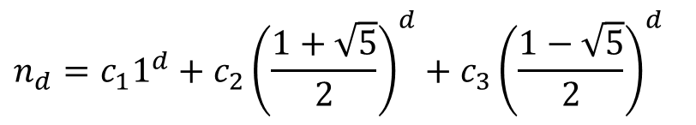
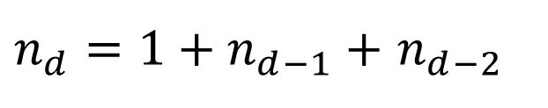
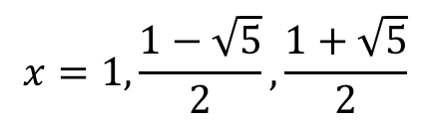
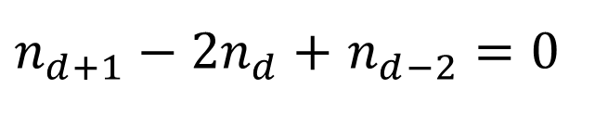
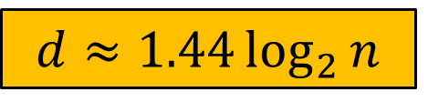
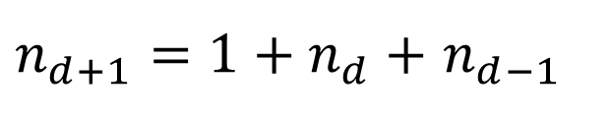
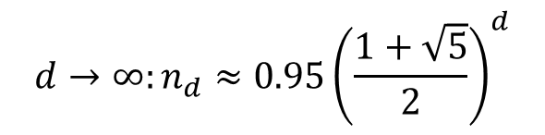
Depth of AVL Tree
What is the depth (d) of AVL tree with n nodes?
$n_{d}={1+n}_{d−1}+$ $n_{d−2}$
1
$n_{d+1}={1+n}_{d}+$ $n_{d−1}$
2
2
-
1
$n_{d+1}−2n_{d}+$ $n_{d−2}=0$
$$x=1,\frac{1−\sqrt{5}}{2},\frac{1+\sqrt{5}}{2}$$
Characteristic eqn :
$$x^{3}−{2x}^{2}+1=0$$
$$n_{d}=c_{1}1^{d}+c_{2}{\left(\frac{1+\sqrt{5}}{2}\right)}^{d}+c_{3}{\left(\frac{1−\sqrt{5}}{2}\right)}^{d}$$
$$d→∞:n_{d}≈0.95{\left(\frac{1+\sqrt{5}}{2}\right)}^{d}$$
$$n_{d}=1+0.95{\left(\frac{1+\sqrt{5}}{2}\right)}^{d}+0.05{\left(\frac{1−\sqrt{5}}{2}\right)}^{d}$$
$$d≈1.44\log_{2}{n}$$

Slide 6





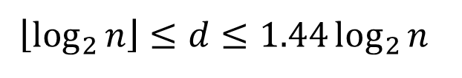

Complexity of AVL Tree
Binary Search Tree
AVL Tree
$$\left\lfloor \log_{2}{n}\right\rfloor ≤d≤n−1$$
best
average
worst
add remove contains
$$O(logn)$$
$$O(logn)$$
$$O(n)$$
treeSort
$$O(nlogn)$$
$$O(nlogn)$$
$$O(n^{2})$$
$$\left\lfloor \log_{2}{n}\right\rfloor ≤d≤1.44\log_{2}{n}$$
best
average
worst
add remove contains
$$O(logn)$$
$$O(logn)$$
$$O(logn)$$
treeSort
$$O(nlogn)$$
$$O(nlogn)$$
$$O(nlogn)$$

Slide 7
How to self-balancing?
Add and remove can be done by the same way as BSTree
After add and remove rebalancing the tree
Tree Rotation
Rotate right child
5
8
5
10
4
8
4
7
7
10
Rotate left child

Slide 8
BSTree: rotateLeftChild
Node rotateLeftChild(Node r)
8
protected virtual Node rotateLeftChild(Node r)
{
Node newRoot = r.left;
r.left = newRoot.right;
newRoot.right = r;
return newRoot;
}
5
10
4
7

Slide 9
BSTree: rotateRigthChild
Node rotateRightChild(Node r)
5
protected virtual Node rotateRightChild(Node r)
{
Node newRoot = r.right;
r.right = newRoot.left;
newRoot.left = r;
return newRoot;
}
4
8
7
10

Slide 10
Implement AVL Tree with BSTree
AVLTree
public class AVLTree : BSTree
{
private class AVLNode : Node{}
public override Node add(Node r, object e){}
public override Node remove(Node r, object e){}
private Node rebalance(Node r){}
private override Node rotateLeftChild(Node r){}
private override Node rotateRightChild(Node r){}
}

Slide 11
AVLNode
rebalanceValue = {-2, -1, 0, 1, 2}
private class AVLNode : Node
{
private int DEPTH;
public AVLNode(object e, Node left, Node right)
: base(e, left, right)
{ setDepth(); }
public void setDepth()
{ DEPTH = 1 + Math.Max(depth(left), depth(right)); }
public int depth(Node n)
{ return n == null ? -1 : ((AVLNode)n).DEPTH; }
public int balanceValue()
{ return depth(right) - depth(left); }
}

Slide 12
AVLTree: add
Node add(Node r, object e)
protected override Node add(Node r, object e)
{
if (r == null)
{
r = new AVLNode(e, null, null);
SIZE++;
}
else
{
r = base.add(r, e);
r = rebalance(r);
}
return r;
}

Slide 13
AVLTree: rebalance
Case 1: unbalance in same direction
Case 2: unbalance in opposite direction
Rotate
Rotate
Opposite
Rotate

Slide 14
AVLTree: rebalance
Node rebalance(Node r)
private Node rebalance(Node r)
{
if (r == null) return r;
int balance = ((AVLNode)r).balanceValue();
if (balance == -2) {
if (((AVLNode)r.left).balanceValue() == 1)
r.left = rotateRightChild(r.left);
r = rotateLeftChild(r);
}
else if (balance == 2) {
if (((AVLNode)r.right).balanceValue() == -1)
r.right = rotateLeftChild(r.right);
r = rotateRightChild(r);
}
((AVLNode)r).setDepth();
return r;
}

Slide 15
AVLTree: remove
Node remove(Node r, object e)
protected override Node remove(Node r, object e)
{
r = base.remove(r, e);
r = rebalance(r);
return r;
}

Slide 16
Class work 1: TreeSort
Compare the processing time of TreeSort of BSTree and AVLTree and visualize it with graph
using System.Diagnostics;
Stopwatch watch = new Stopwatch();
watch.Reset();
watch.Start();
// Do something
watch.Stop();
chart1.ChartAreas[0].AxisX.Title = "x"; // x label
chart1.ChartAreas[0].AxisY.Title = "y"; // y label
chart1.Series.Clear(); // remove default series
Series data = chart1.Series.Add("Data");
data.ChartType = SeriesChartType.Line;
data.MarkerStyle = MarkerStyle.Circle;
for (int n = 1; n < 100; n++)
{
data.Points.AddXY(n, n*n); // add x-y point
chart1.Update(); // real-time updating
}

